Slide 1
GEO-SEARCHER
By:
Akshit Sharma
211435

Slide 2
INTRODUCTION
The Geo Searcher project aims to develop a web application that provides users with the ability to search for a specific place and display its corresponding map. By utilizing the Google Maps API, the application allows users to explore and visualize various locations worldwide. The project primarily focuses on enhancing user experience and providing a user-friendly interface for seamless map searching.
The Geo Searcher application enables users to easily search for a place by entering its name in a search box. Upon submission, the application fetches the desired location's geocode information using the Google Maps Geocoder service. The geocoded data is then utilized to generate a map centred on the specified location, providing users with an interactive visualization of the desired place.

Slide 3
OBJECTIVES
1. Providing a user-friendly interface: The project prioritizes user experience by designing a visually appealing and intuitive user interface. Users can effortlessly search for a place and obtain a corresponding map with minimal effort.
2. Integration with the Google Maps API: The project leverages the powerful features of the Google Maps API to retrieve geocode information and generate interactive maps. The API's geocoding service enables the conversion of place names into geographic coordinates, facilitating accurate map visualization.

Slide 4
3. Seamless map generation: The project aims to deliver an efficient map generation process. Once a place is submitted, the application fetches the geocode information and generates a map centred on the specified location. The process is designed to be quick and reliable, ensuring a smooth user experience.
4. Customizability and extensibility: The Geo Searcher project aims to provide room for customization and future extensibility. The application's design and code structure enable developers to easily add new features, incorporate additional functionalities, and enhance the project based on specific requirements.

Slide 5
OVERVIEW
The provided code that creates a web page for the Geo Searcher application. When a user enters the name of a place in the search box and clicks the "Go" button, the code retrieves the entered place value. It then uses the Google Maps API to geocode the place, obtaining its geographic coordinates.
After geocoding, the code creates a map centred on the specified location using the Google Maps API. The map is displayed on the web page within a designated <div> element. Additionally, a marker is placed on the map to indicate the exact location of the searched place.
The code includes event handlers and functions to handle form submission, geocoding, map creation, and error handling. It ensures that the user receives feedback if the geocoding process encounters any issues, displaying an alert with the corresponding status message.
Overall, the code provides a basic implementation of the Geo Searcher application, allowing users to search for a place and visualize its map using the Google Maps API.

Slide 6
CONCLUSION
The Geo Searcher project successfully achieved its primary goal of developing a web application that allows users to search for a specific place and display its corresponding map. By integrating the Google Maps API, users can enter a place name and retrieve an interactive map centred on the desired location. The project's implementation provides a user-friendly interface, efficient map generation, and leverages the capabilities of the Google Maps API. In case the API is unable to fetch, then as a backup, we also can redirect the user to Google Maps.

Slide 7
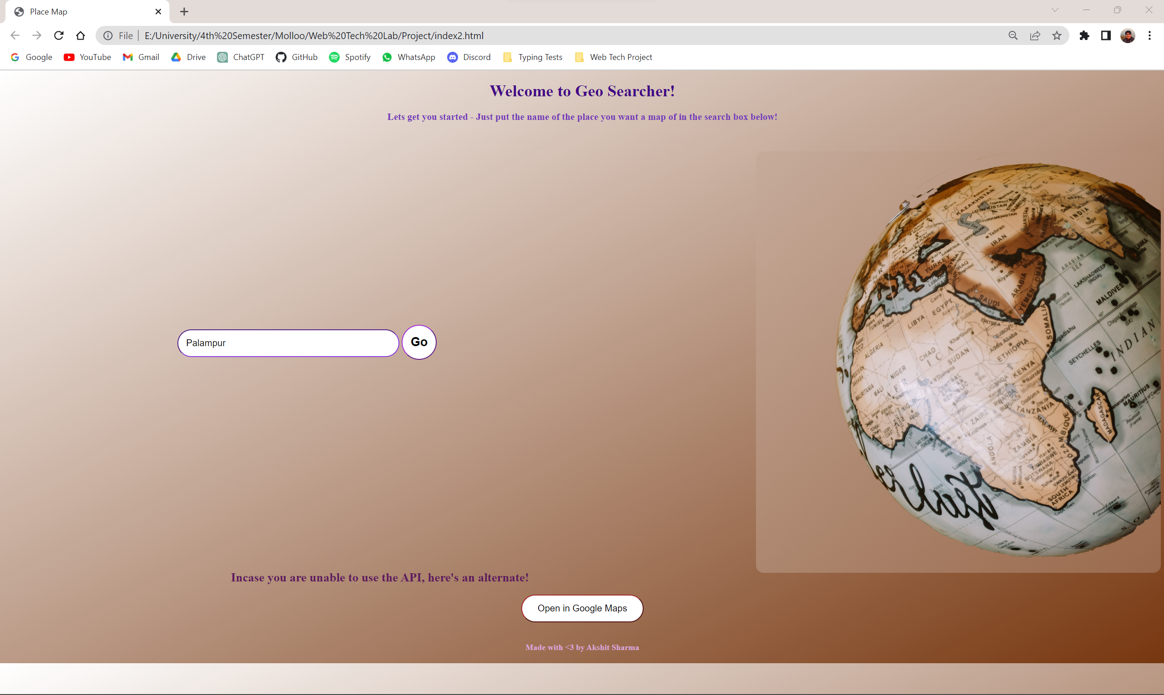
OUTPUT

Slide 8
THANK YOU

